Slide 1
A FEELD Case Study on Data Exposure
Examining Access Control Vulnerabilities in GraphQL

Slide 2




Whoami?
Senior Pentester at FORTBRIDGE
Bogdan Tiron
Accreditations: OSWE, OSCP, CREST CRT, DevSecOps, GCP Security, GCP Architecture
> 10 years of experience in security
Past History: Lloyds Bank, GFK, JPMorgan Bank, bet365

Slide 3
WhAT is this TALK About?

Slide 4
This is about The Importance of Access Controls

Slide 5
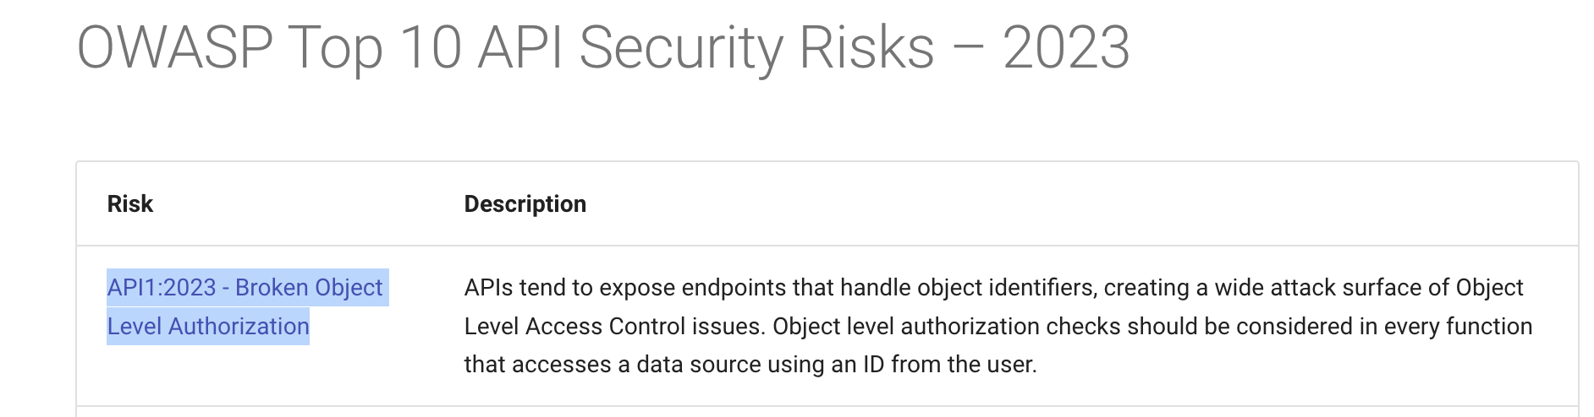

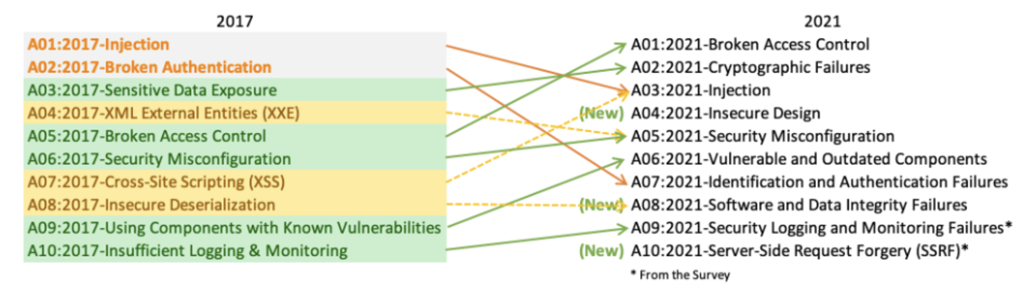
OWASP Top 10 - #1 Security Risk
APIs: #1 Broken Object Level Authorization Category
Web Apps: #1 Broken Access Controls Category

Slide 6
About Feeld
2014 – launched as 3nder
2016 - renamed to Feeld
a dating mobile app, like Tinder/Bumble/etc
you can filter by distance, by age, by gender (>10), couples, and by location.
for premium users, you can also search by the type of kink, threeways/group scenarios (ex: couples, group, MMF, FFM, MFMF, others), or the type of relationship you are interested in (ex: casual, ENM, FWB, others).
>1 Million Downloads (Android Play Store)

Slide 7
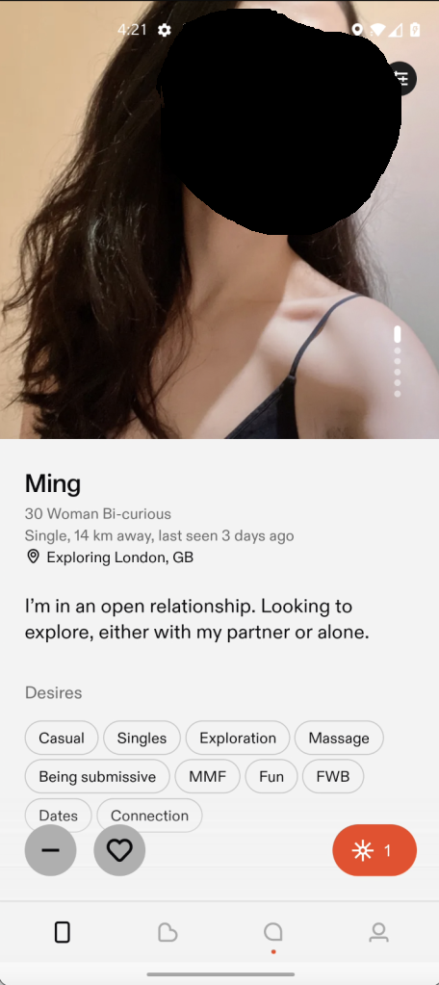
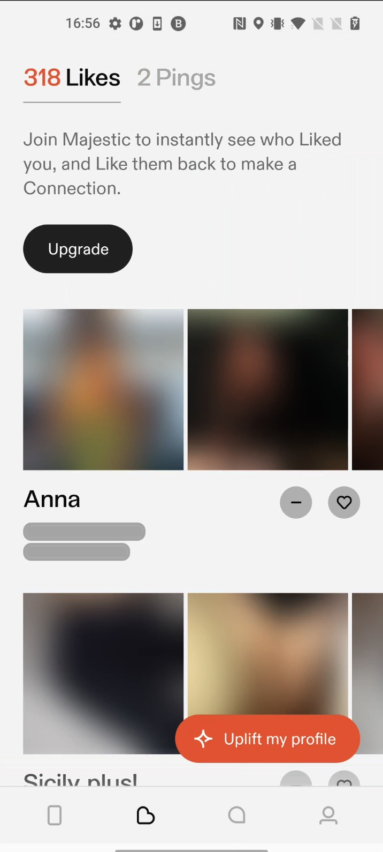
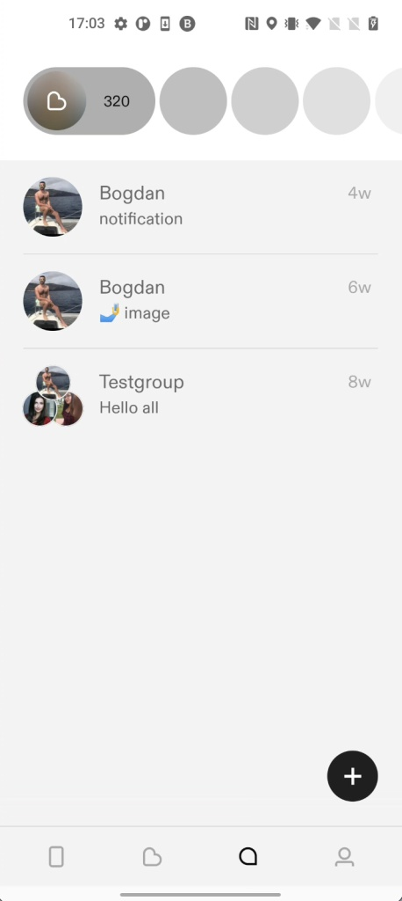
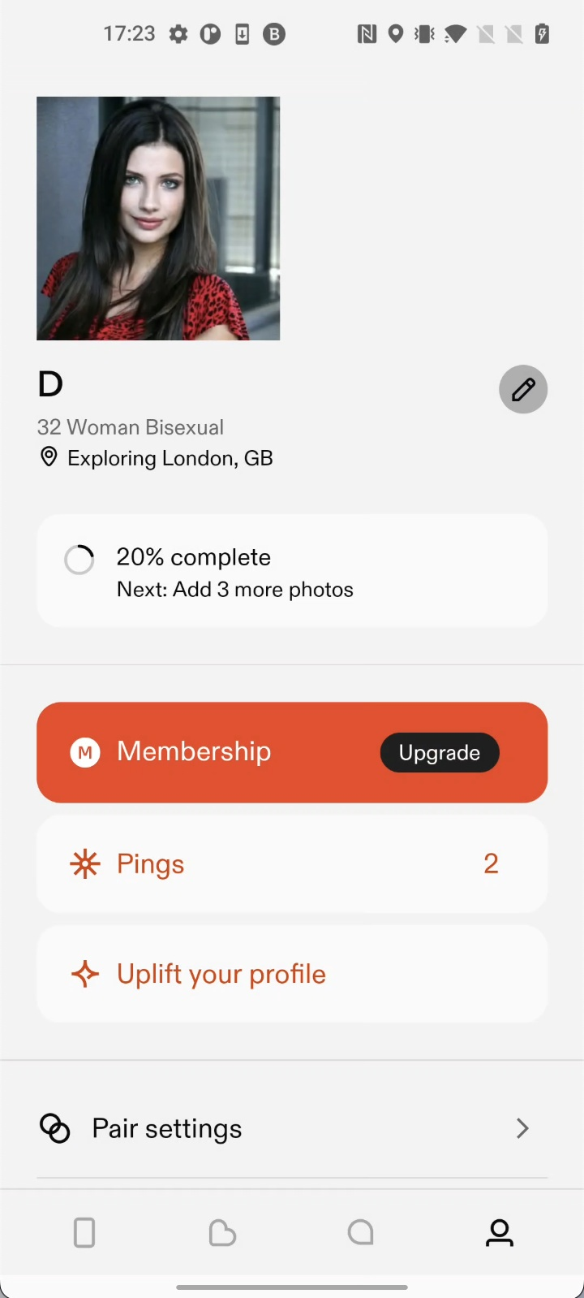
FEELD Menus
‘Discover Profiles’ Menu
‘Who liked you’ Menu
‘Messages’ Menu
‘My Profile’ Menu
‘basic’ users cannot view/interact with it

Slide 8
FEELD Case Study - Vulnerabilities
#3 Broken Object Property Level Authorization Category
Disclosure of profile information to non-premium users
Read other people’s messages
Unauthenticated access to other people’s attachments (photos & videos) from their chats
Delete, recover and edit other people’s messages
Update someone else’s profile information
Get a ‘Like’ from any user profile
Send messages in other people’s chat
View other people’s matches
#1 Broken Object Level Authorization Category

Slide 9
Vulnerability #1 - Disclosure of profile information to non-premium users
#3 Broken Object Property Level Authorization Category
Details: The ‘basic’ user will no longer need to pay for a ‘premium’ subscription to get a premium benefit.
As a basic user, in the ‘Likes’ menu, you see who liked your profile, but you only get limited information, such as:
the name and
the blurred photos of the ‘like’ sender,
As a premium user you get all the information available about the sender.
However, if you use a proxy tool such as Burp to intercept the request and response, you will find in the response all the information available about the ‘like’ senders, just like a premium user.

Slide 10
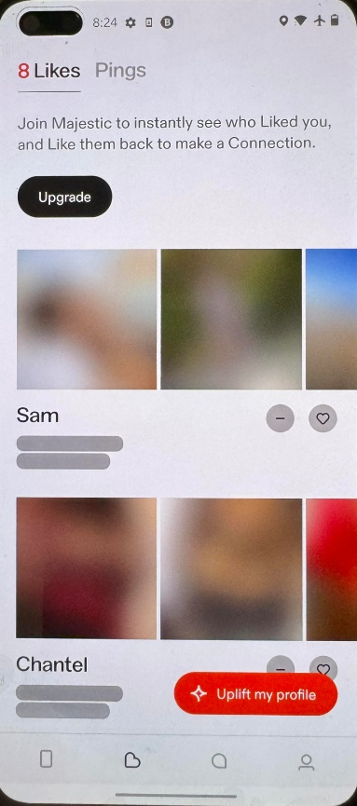
Vulnerability #1 - Disclosure of profile information to non-premium users
#1 Broken Object Level Authorization Category
Reproduction steps: 1. Go to the ‘Likes’ menu to see who liked or pinged us, as seen on the right. But beside their names and their blurred photos, we do not have any other information.

Slide 11
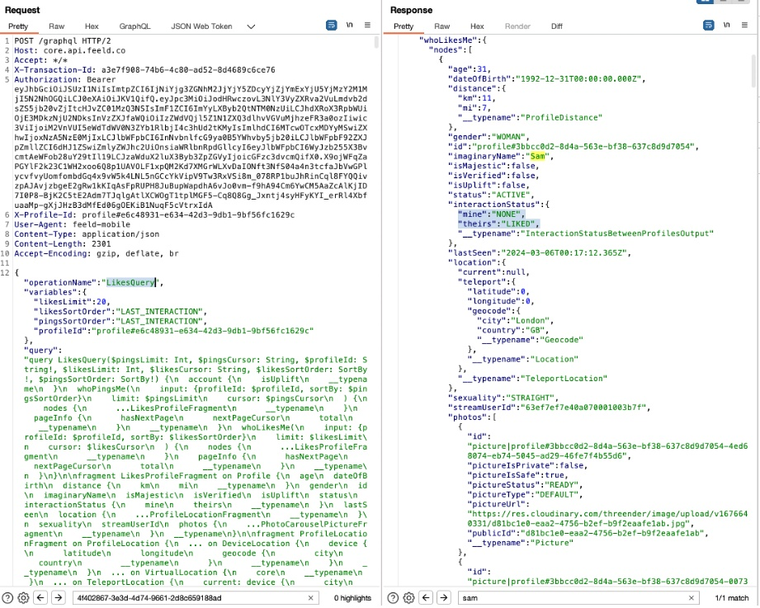
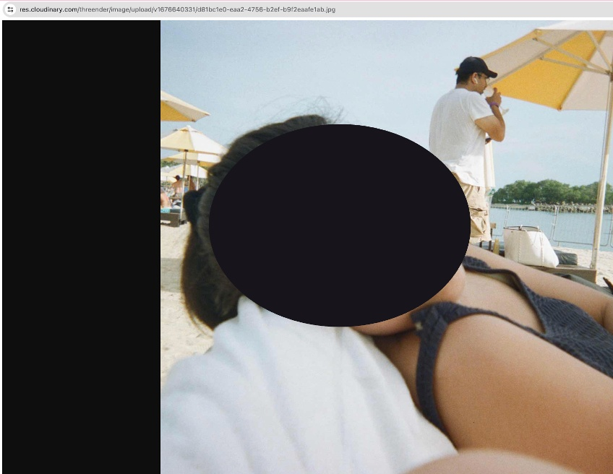
Vulnerability #1 - Disclosure of profile information to non-premium users
Reproduction steps:
2. However, if we intercept the request in Burp and check the response, as seen below, we will see that we have all the information about the user (age, distance, all their profile photos, streamUserId), including unauthenticated access to their profile photos stored on res.cloudinary.com.
In addition, using the ‘streamUserId’ value found in the response we can exploit the next vulnerability ‘Read other people’s messages’ and read Sam’s messages.

Slide 12
Vulnerability #2 - Read other people’s messages
#1 Broken Object Level Authorization Category
Details: We can read other people’s messages in the chat. In order to do that, we will need to get our victim’s ‘streamUserId’ value, which is disclosed in different API requests.

Slide 13
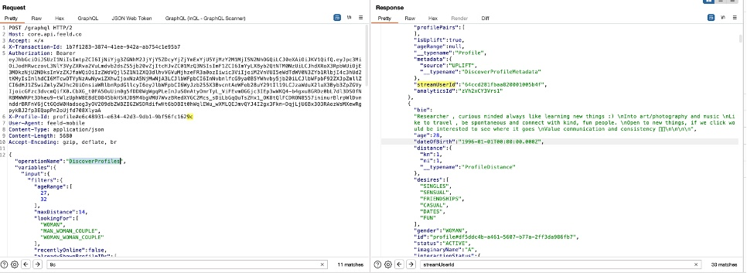
Vulnerability #2 – Read other people’s messages
Reproduction steps:
Go to the ‘Discover profiles’ menu.
Intercept the /graphql request with operationName: ‘DiscoverProfiles’. Get a ‘streamUserId parameter value of the target user from the response, as seen on the right:
‘StreamUserId’ is: 64ccd281fbaa820001005b4f , and belongs to user ‘Chlo’.

Slide 14
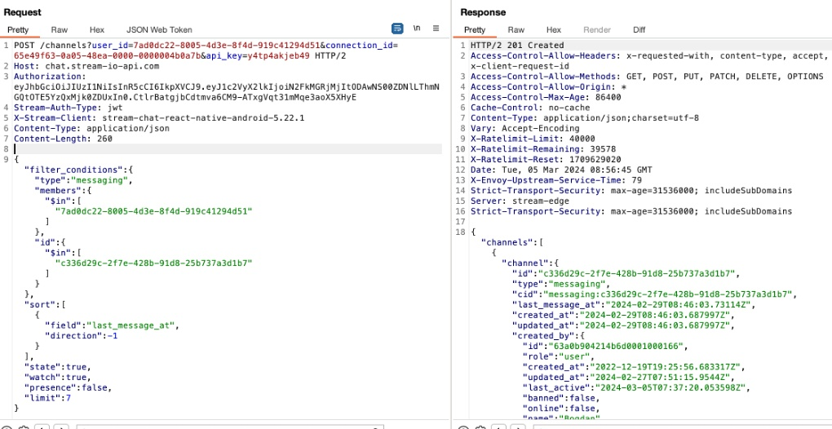
Vulnerability #2 – Read other people’s messages
Reproduction steps:
3. Now go to the ‘Message’ menu, and intercept the request to the endpoint: https://chat.stream-io-api.com/channels?user_id=&connection_id=&api_key=y4tp4akjeb49 ,such as the one below:

Slide 15
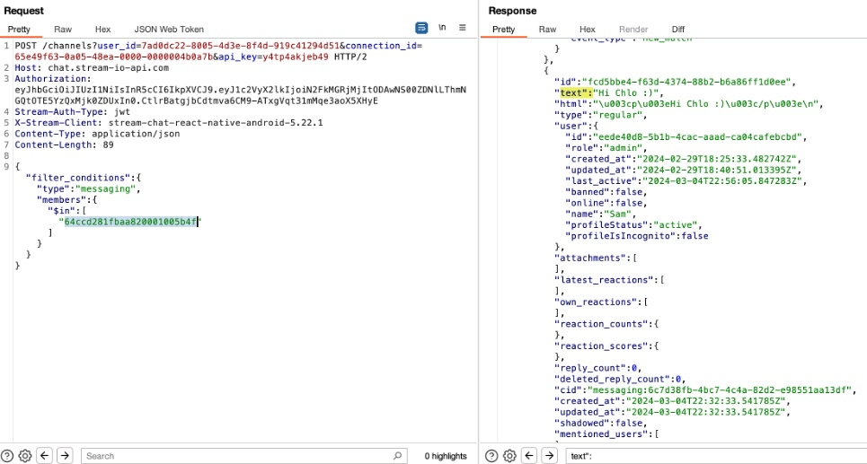
Vulnerability #2 – Read other people’s messages
Reproduction steps:
4. Remove all the request parameters except: ‘member’:{‘in’:[“<value>”] , and add the victim’s ‘streamUserId’ as <value> , as seen below:

Slide 16
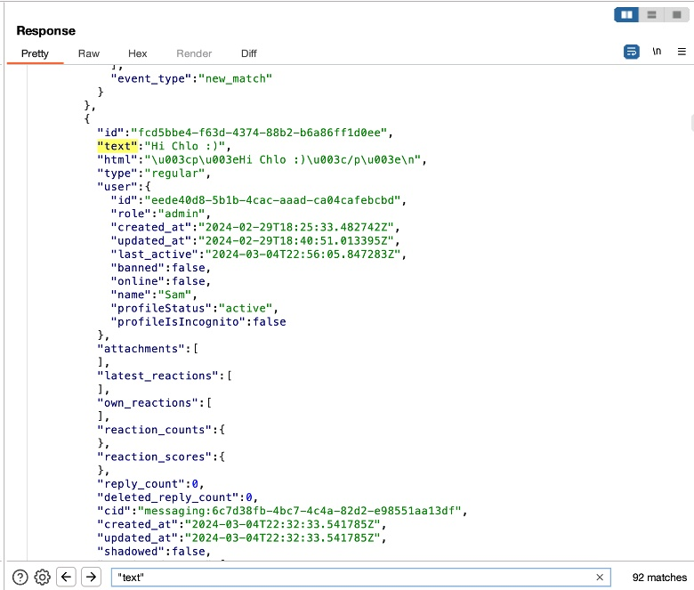
Vulnerability #2 – Read other people’s messages
Reproduction steps: 5.If we search in the response by “text” we can see the total number of messages to and from our victim ‘Chloe:

Slide 17
Vulnerability #3 – Unauthenticated access to other people’s attachments (photos & videos) from their chats
#1 Broken Object Level Authorization Category
Details: We can build upon the previous issue: “Read other people’s messages”. To do that, we will need to get our victim’s ‘streamUserId’ value, which is disclosed in different API requests.
There are 2 types of attachments:
Photos
Replay-able
Time-limited (5-15 seconds – after which becomes unavailable)
2. Videos
Replay-able
Play-once only
As an attacker, we can access all of the following unauthenticated:
Photos replay-able
Photos time-limited
Videos replay-able
Videos play-once

Slide 18
Vulnerability #3 – Unauthenticated access to other people’s attachments (photos & videos) from their chats
#1 Broken Object Level Authorization Category
Final result:
Unauthenticated: https://res.cloudinary.com/threender/image/upload/s–QQjZiJxc–/d4e74e59-430d-403f-b1c5-9c8208472007
Authenticated: https://core.api.feeld.co/cdn/chat-attachment/x<sender-guid>/c07c3360-c787-4be9-9cd6-b1ef9d06fff4 https://core.api.feeld.co/cdn/chat-attachment/x<receiver-guid>/c07c3360-c787-4be9-9cd6-b1ef9d06fff4

Slide 19
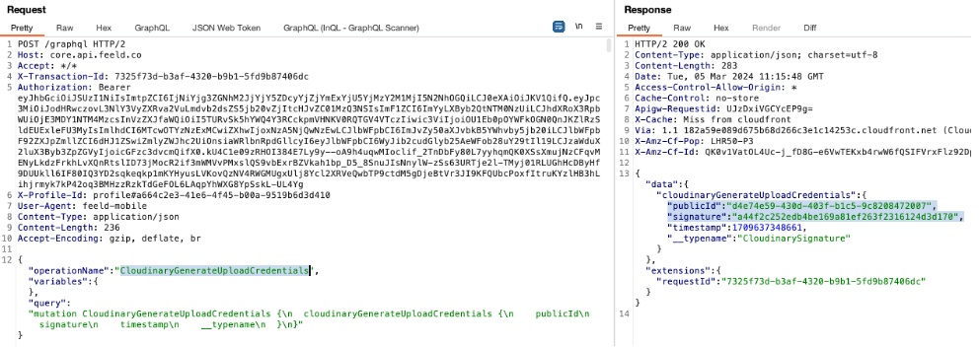
Vulnerability #3 – Unauthenticated access to other people’s attachments (photos & videos) from their chats
Reproduction steps: Instance 1: Uploading replay-able photos
1.Let’s upload in our chat, a normal replay-able photo. So, the first request is ‘Generate Upload Credentials’ for uploading on ‘api.cloudinary.com’:

Slide 20
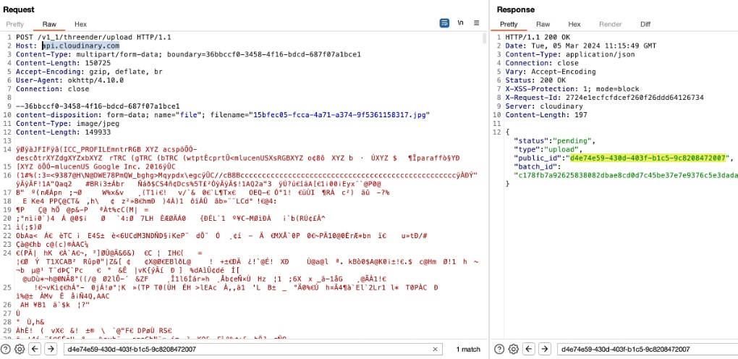
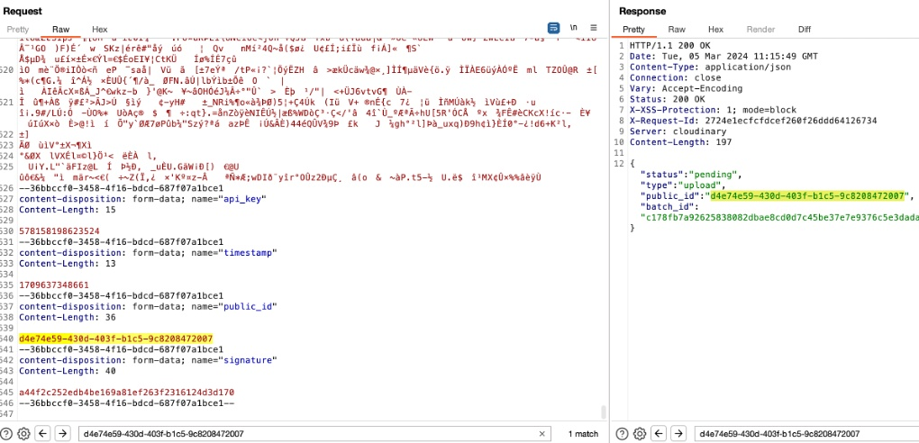
Vulnerability #3 – Unauthenticated access to other people’s attachments (photos & videos) from their chats
Reproduction steps: Instance 1: Uploading replay-able photos
2. Then we send a photo upload request to api.cloudinary.com using the above generated ‘publicId’ and ‘signature’ values, plus an api_key and timestamp parameters:

Slide 21
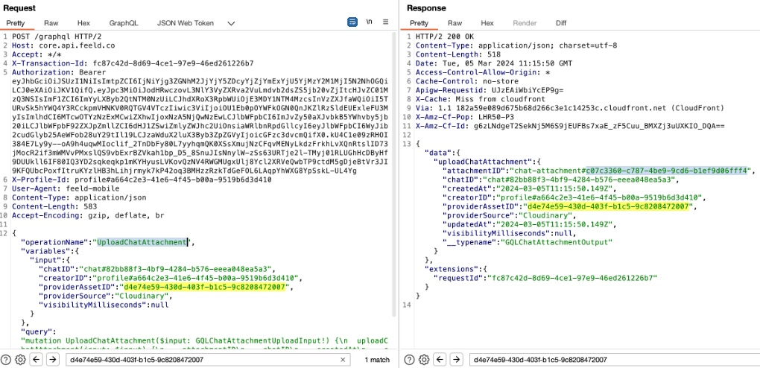
Vulnerability #3 – Unauthenticated access to other people’s attachments (photos & videos) from their chats
Reproduction steps: Instance 1: Uploading replay-able photos
3. Next request done is: ‘UploadChatAttachment’ which gets the above unique public_id of the image from api.cloudinary.com and is passed to core.api.feeld.co, as seen below. I suspect this request is to copy the photo from api.cloudinary.com to core.api.feeld.co.

Slide 22
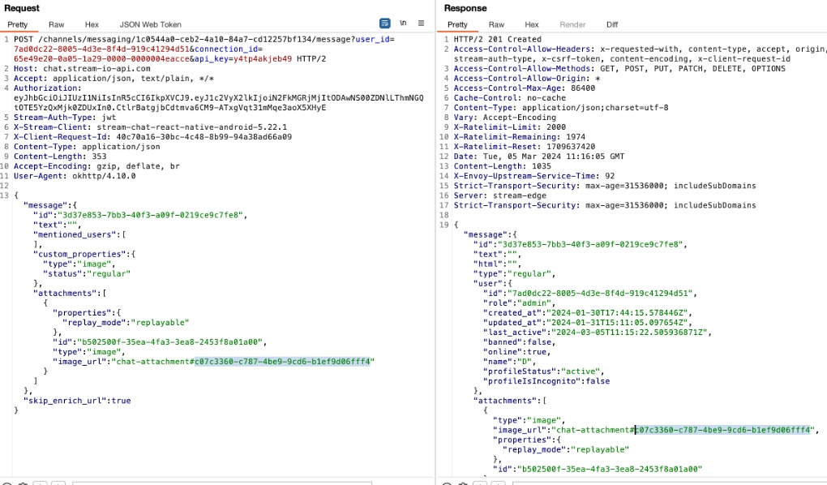
Vulnerability #3 – Unauthenticated access to other people’s attachments (photos & videos) from their chats
Reproduction steps: Instance 1: Uploading replay-able photos
4. A unique ‘attachmentID’ parameter will be returned above in the response. This ‘attachmentID’ will be used and passed in the chat, as seen below:

Slide 23
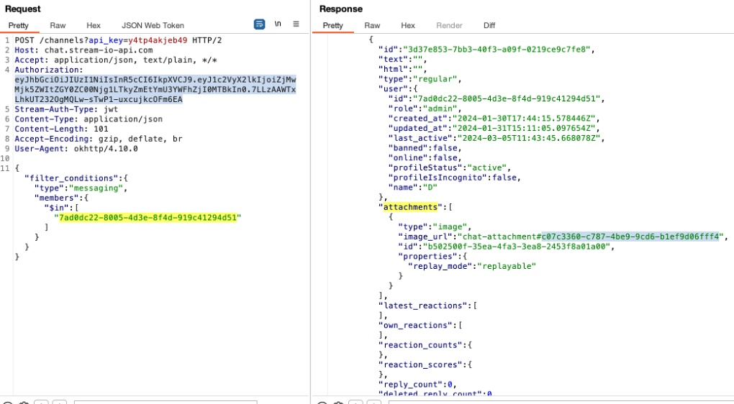
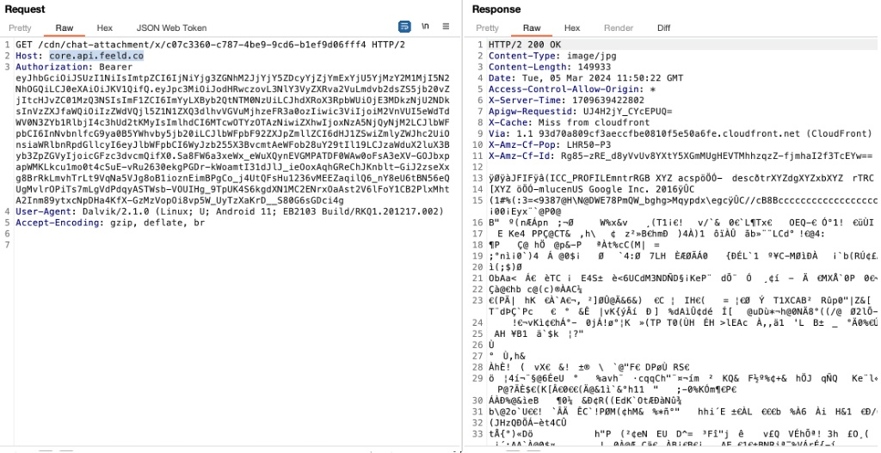
Vulnerability #3 – Unauthenticated access to other people’s attachments (photos & videos) from their chats
Reproduction steps: Instance 1: Uploading replay-able photos
5. Now to get the photo authenticated, as any other user, we make the following request, using the above attachmentID: https://core.api.feeld.co/cdn/chat-attachment/x/c07c3360-c787-4be9-9cd6-b1ef9d06fff4 Note: In the above request path, initially instead of ‘x’ it was the ‘ProfileId’ guid value of the sender or receiver of the photo, but deleting it works fine, so I just left an ‘x’ for an easier read.

Slide 24
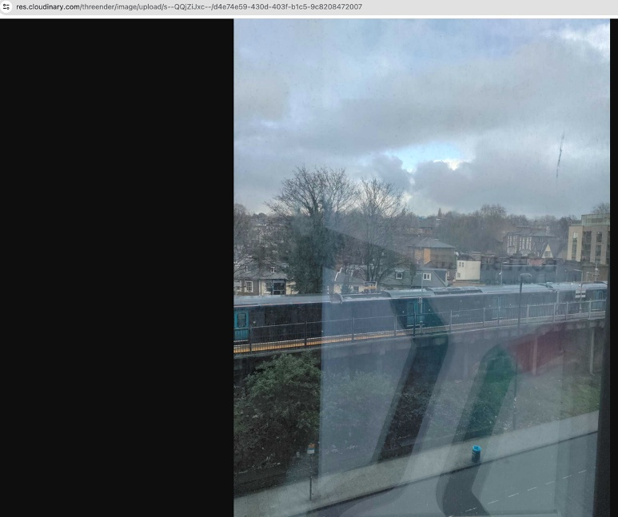
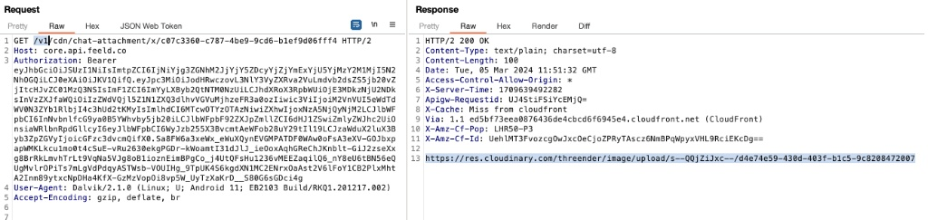
Vulnerability #3 – Unauthenticated access to other people’s attachments (photos & videos) from their chats
Reproduction steps: Instance 1: Uploading replay-able photos
6.Now, to get the same photo but from cloudinary.com, unauthenticated, prepend /v1/ to the above request, as seen below, and you will get the ‘url’ pointing to the original photo: https://res.cloudinary.com/threender/image/upload/s–QQjZiJxc–/d4e74e59-430d-403f-b1c5-9c8208472007

Slide 25
Vulnerability #3 – Unauthenticated access to other people’s attachments (photos & videos) from their chats
Reproduction steps: Instance 2: Uploading time-limited photos
Note: There are 2 main differences from the previous process for replay-able photos.
when uploading ‘time-limited’ photos, we pass an extra parameter ‘visibilityMilliseconds:15000’.
for accessing the photo, we use the ‘profileId’ GUID value of the victim that uploaded the photo, rather than the ‘x’ value used in the path for replay-able photos. If their chat counterpart uploaded the ‘time-limited’ photo, we need to return to the ‘Discover profiles’ menu to locate their <profileId> GUID value, which is mandatory for accessing these photos.

Slide 26
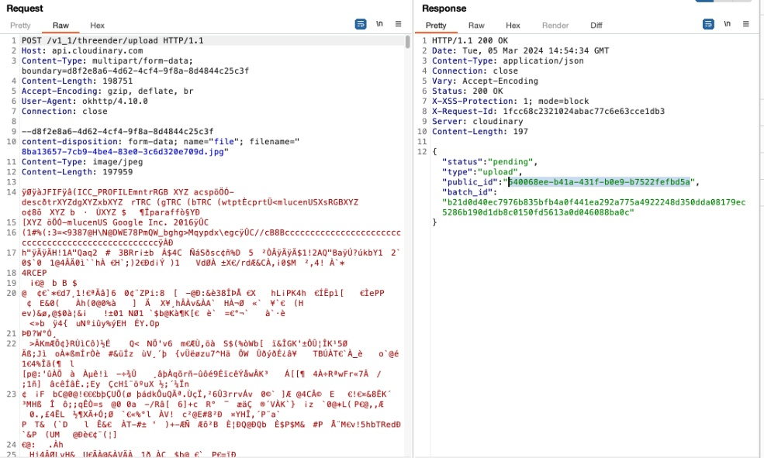
Vulnerability #3 – Unauthenticated access to other people’s attachments (photos & videos) from their chats
Reproduction steps: Instance 2: Uploading time-limited photos
1. A request will be made to api.cloudinary.com to upload the photo:

Slide 27
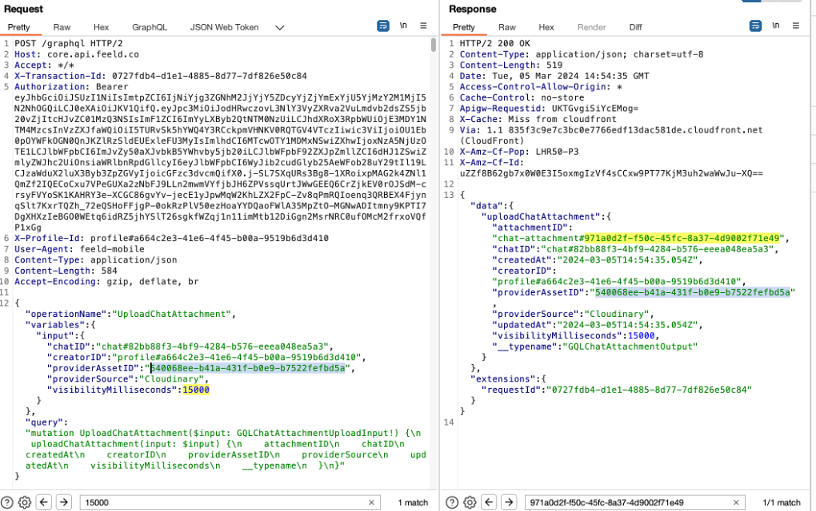
Vulnerability #3 – Unauthenticated access to other people’s attachments (photos & videos) from their chats
Reproduction steps: Instance 2: Uploading time-limited photos 2. Copying the photo from: cloudinary.com to core.api.feeld.co:

Slide 28
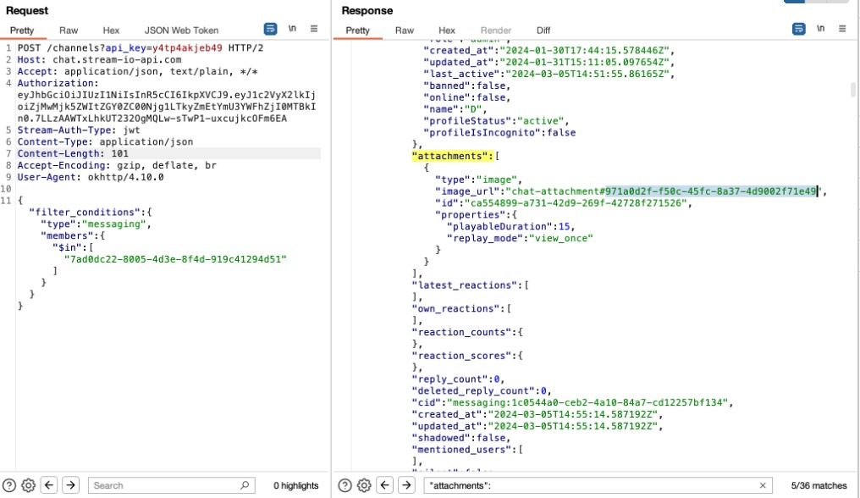
Vulnerability #3 – Unauthenticated access to other people’s attachments (photos & videos) from their chats
Reproduction steps: Instance 2: Uploading time-limited photos 3.Then, if we read again the chat using the previous vulnerability ‘Read other people’s messages’, we can find the attachmentId to use in order to get the photo:

Slide 29
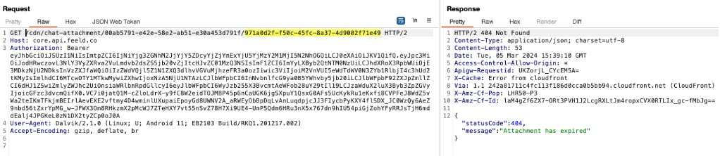
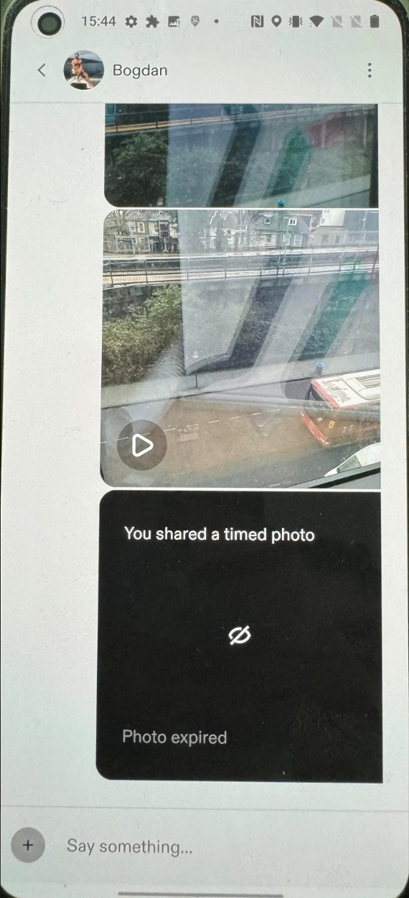
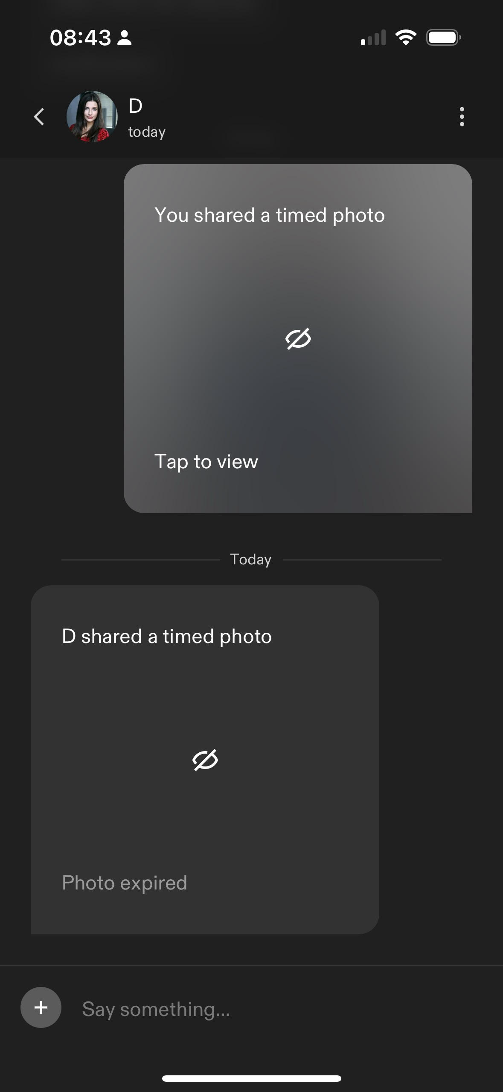
Vulnerability #3 – Unauthenticated access to other people’s attachments (photos & videos) from their chats
Reproduction steps: Instance 2: Uploading time-limited photos 4.To retrieve the image, we will need the ‘profileId’ guid of our victim that uploaded the photo, which we already have from the ‘Discover Profile’ menu when we have chosen this target victim. Thus, the 2 urls to get the photo authenticated are:
https://core.api.feeld.co/cdn/chat-attachment/<receiver’s_profileId>/971a0d2f-f50c-45fc-8a37-4d9002f71e49 . However, 5-15 seconds after accessing this endpoint, the photo at this endpoint will be deleted . You must access it before the receiver.
https://core.api.feeld.co/cdn/chat-attachment/<victim’s_profileId>/971a0d2f-f50c-45fc-8a37-4d9002f71e49 . This will always return the photo to authenticated users.
The view in the Android app after the sender accessed his time-limited photo: ‘Photo expired’, and is not shown anymore in the app.
The view in the iOS app after the sender accessed his time-limited photo at the top: ‘Tap to view’, and is still shown in the app.

Slide 30
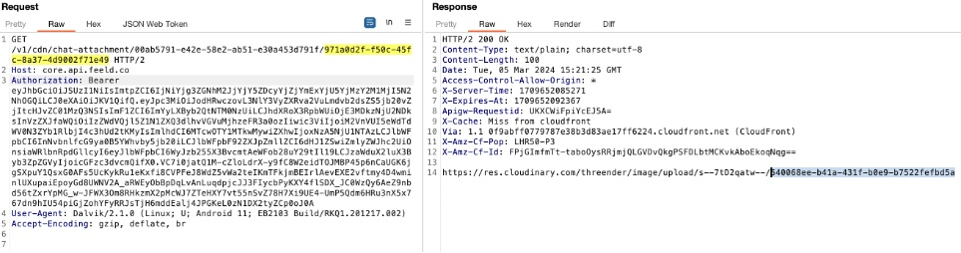
Vulnerability #3 – Unauthenticated access to other people’s attachments (photos & videos) from their chats
Reproduction steps: Instance 2: Uploading time-limited photos 5. We can use the following endpoint: https://core.api.feeld.co/v1/cdn/chat-attachment/<victim’s_profileId>/971a0d2f-f50c-45fc-8a37-4d9002f71e49 which will return a url with the photo stored on res.cloudinary.com .

Slide 31
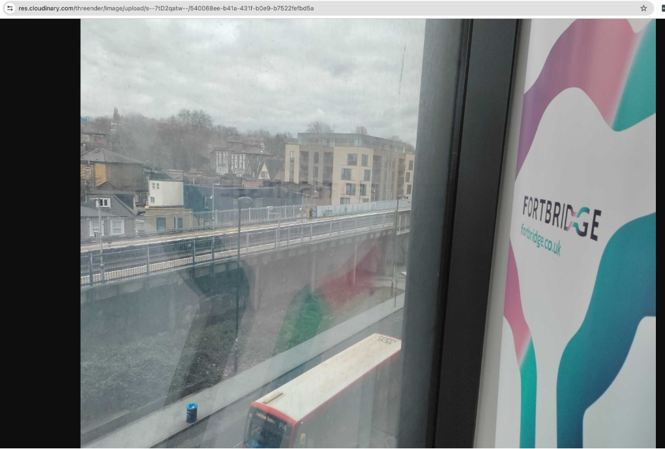
Vulnerability #3 – Unauthenticated access to other people’s attachments (photos & videos) from their chats
Reproduction steps: Instance 2: Uploading time-limited photos 6. The returned url for unauthenticated access is: https://res.cloudinary.com/threender/image/upload/s–7tD2qatw–/540068ee-b41a-431f-b0e9-b7522fefbd5a The only thing random in the above url, in case you want to brute-force it, are the 8 characters ‘7tD2qatw‘.

Slide 32
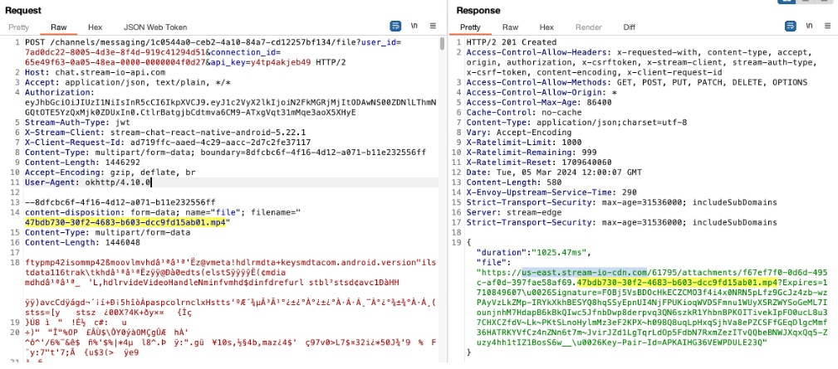
Vulnerability #3 – Unauthenticated access to other people’s attachments (photos & videos) from their chats
Reproduction steps: Instance 3: Uploading normal video 1.Pick a chat, select ‘upload video’ option, record a video and submit it in the chat. The below requests will be made. The video will be uploaded to: us-east.stream-io-cdn.com:

Slide 33
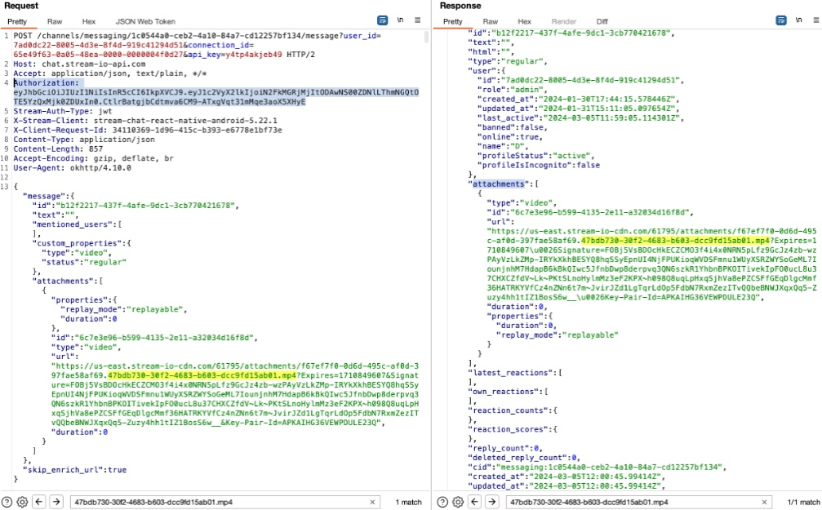
Vulnerability #3 – Unauthenticated access to other people’s attachments (photos & videos) from their chats
Reproduction steps: Instance 3: Uploading normal video 2.The url from the response will be passed in the chat, as seen below:

Slide 34
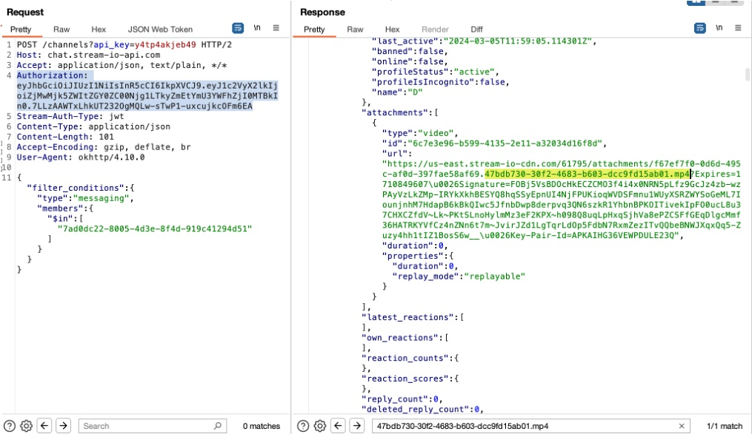
Vulnerability #3 – Unauthenticated access to other people’s attachments (photos & videos) from their chats
Reproduction steps: Instance 3: Uploading normal video 3.If we again read this chat as the attacker, using the previous vulnerability ‘Read other people’s messages’, we can see the url to the video in the response, as seen below: We have to replace ‘\u0026’ for ‘&’ in it.

Slide 35
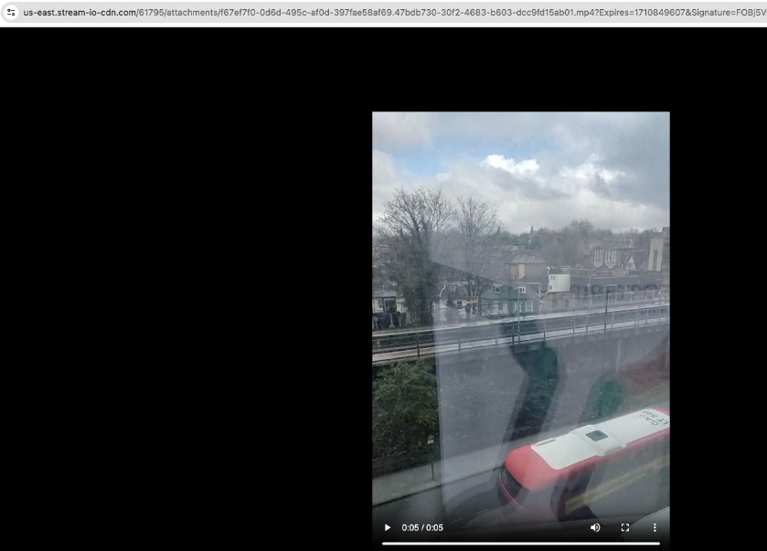
Vulnerability #3 – Unauthenticated access to other people’s attachments (photos & videos) from their chats
Reproduction steps: Instance 3: Uploading normal video 4. Now we can go to the above url unauthenticated.

Slide 36
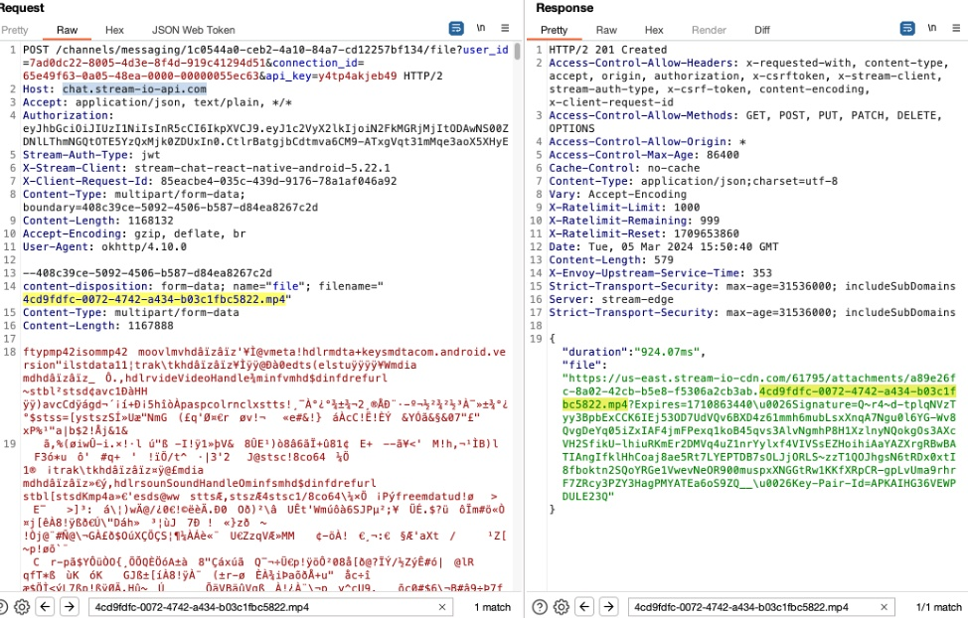
Vulnerability #3 – Unauthenticated access to other people’s attachments (photos & videos) from their chats
Reproduction steps: Instance 4: Uploading ‘play-once’ videos 1.Upload a video, as in instance 3, but set it to ‘play once’. The following requests will be made. The video will be uploaded to: chat.stream-io-api.com as seen on the right:

Slide 37
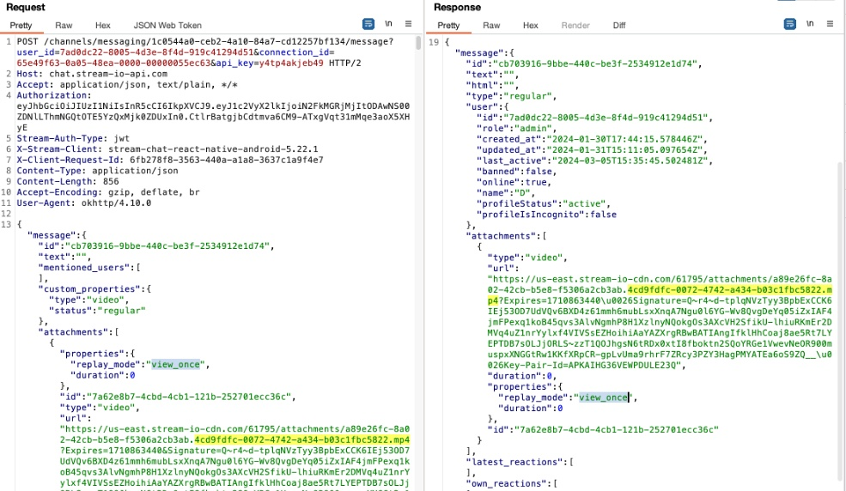
Vulnerability #3 – Unauthenticated access to other people’s attachments (photos & videos) from their chats
Reproduction steps: Instance 4: Uploading ‘play-once’ videos 2.The returned url will also be sent in the chat in a subsequent request, as seen below:

Slide 38
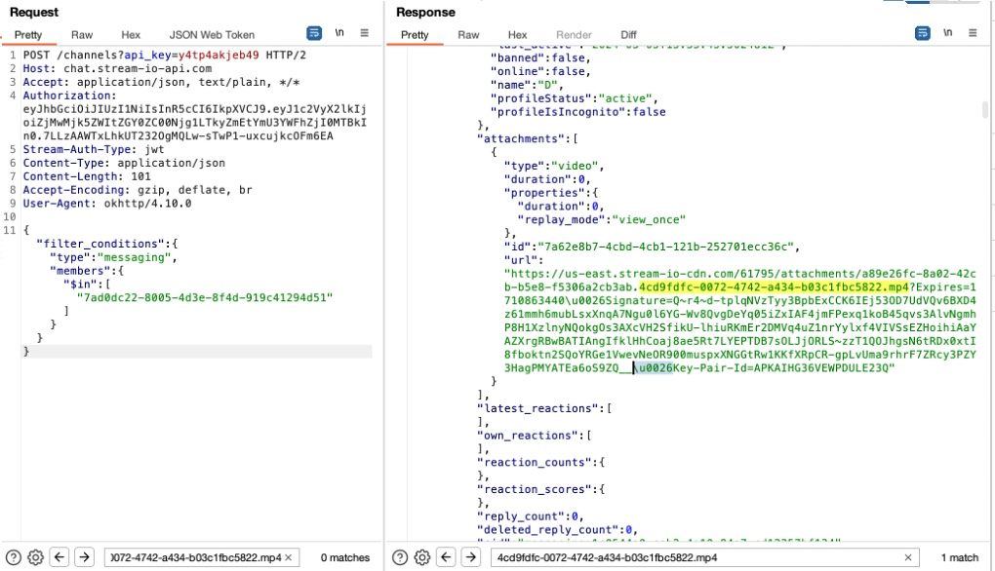
Vulnerability #3 – Unauthenticated access to other people’s attachments (photos & videos) from their chats
Reproduction steps: Instance 4: Uploading ‘play-once’ videos 3.Now, an attacker can read our chat using the previous vulnerability ‘Read other people’s chat’ and extract this url, as seen below. The url can be extracted from the response and the \u0026 character replaced with &.

Slide 39
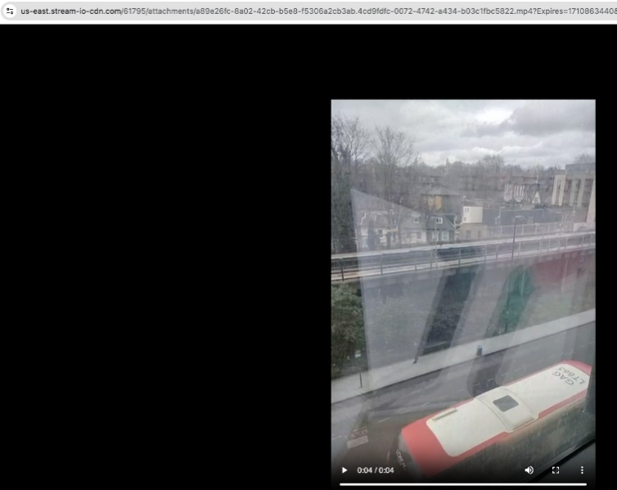
Vulnerability #3 – Unauthenticated access to other people’s attachments (photos & videos) from their chats
Reproduction steps: Instance 4: Uploading ‘play-once’ videos 4.Thus, we can watch the video unauthenticated and is replay-able:

Slide 40
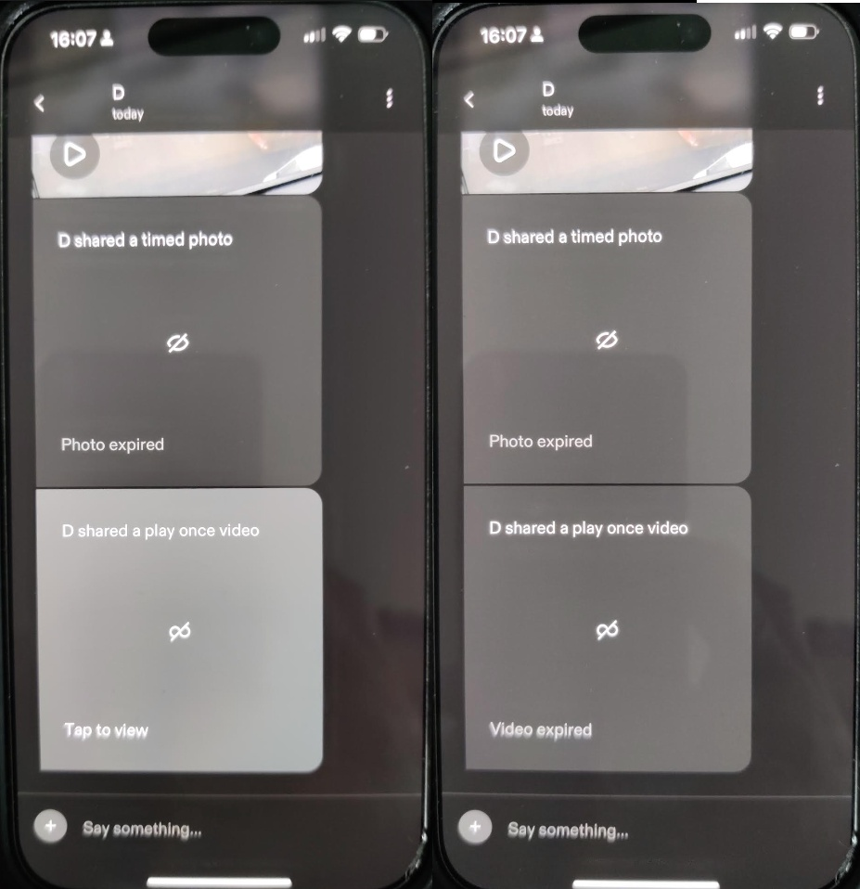
Vulnerability #3 – Unauthenticated access to other people’s attachments (photos & videos) from their chats
Reproduction steps: Instance 4: Uploading ‘play-once’ videos 5.The receiver of the ‘play-once’ video, will have no knowledge of the attack. He can still see the video, but only once. After he sees the video, it will say ‘video expired’.
‘Before’ and ‘after’ the receiver sees the video once.

Slide 41
Vulnerability #4 –Delete, recover and edit other people’s messages
#1 Broken Object Level Authorization Category
Details: We discovered that we can recover other people’s messages that were deleted in a chat. In addition, we can edit and delete other people’s messages. In order to do that, we will need the unique ‘messageId’ value of the message that we want to recover. This is easy to get because when we read our victim’s messages, each message has its messageId next to it.
Instance: https://chat.stream-io-api.com/messages/<MessageId> (Methods: DELETE and PUT)

Slide 42
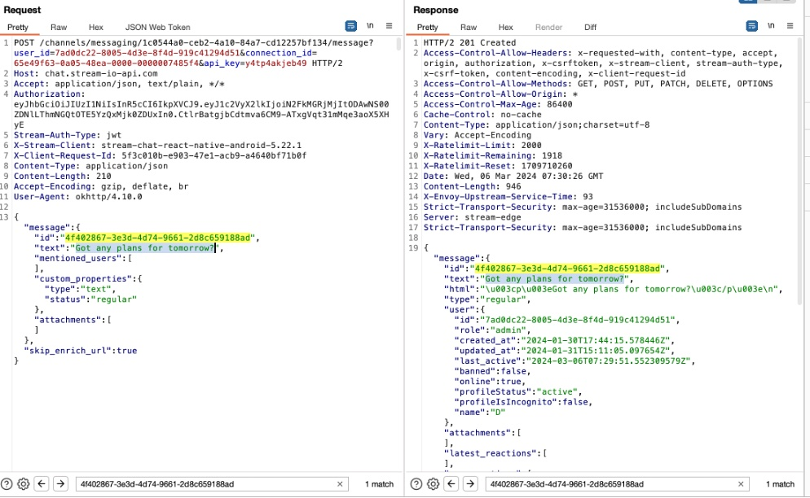
Vulnerability #4 –Delete, recover and edit other people’s messages
Reproduction steps:
Use a proxy tool (Burp) to intercept the traffic.
Enter a chat and leave a message to someone:

Slide 43
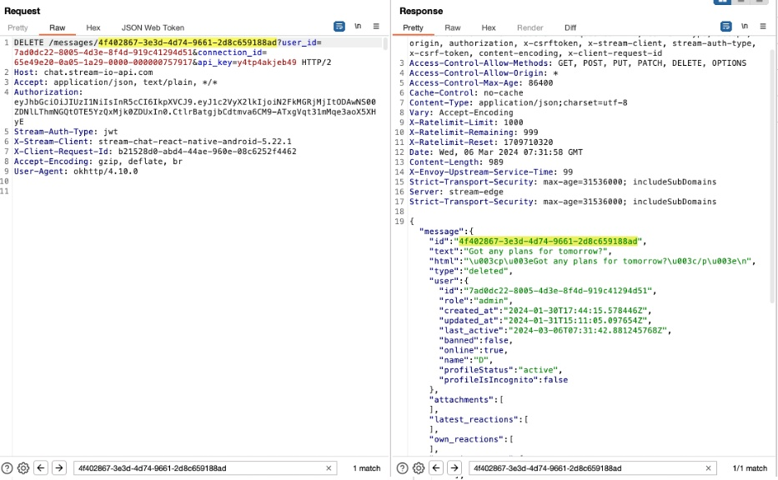
Vulnerability #4 –Delete, recover and edit other people’s messages
Reproduction steps:
3.Delete the message:

Slide 44
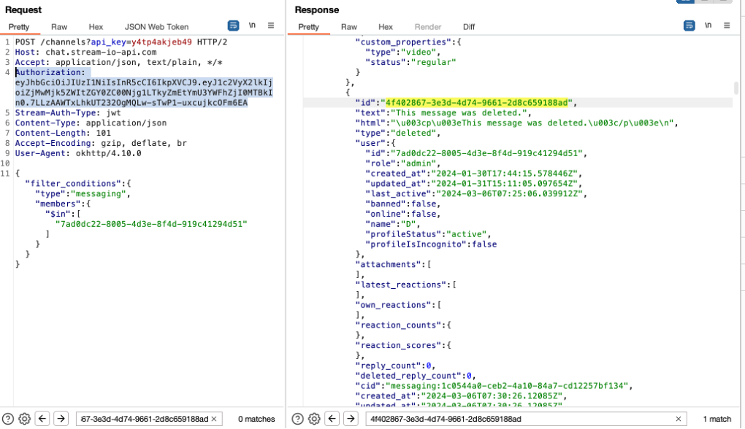
Vulnerability #4 –Delete, recover and edit other people’s messages
Reproduction steps:
4.Now let’s read the chat as the attacker user using the above vulnerability ‘Read other people’s messages’. It will say, ‘This message was deleted’, as seen below:

Slide 45
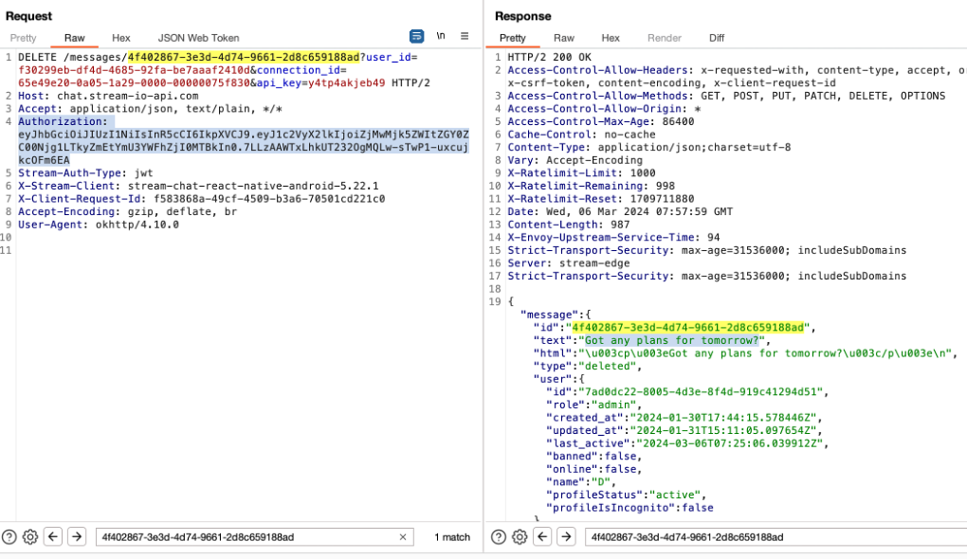
Vulnerability #4 –Delete, recover and edit other people’s messages
Reproduction steps:
5.Now if we call the same DELETE request, as the attacker, we will get back the original message:

Slide 46
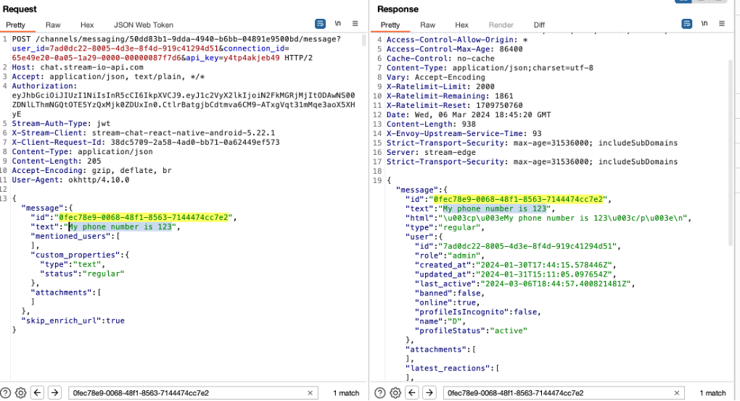
Vulnerability #4 –Delete, recover and edit other people’s messages
Reproduction steps:
Instance 2: Edit a message, as a different user than the participants in the chat
1.First, let’s send a message and intercept the request:

Slide 47
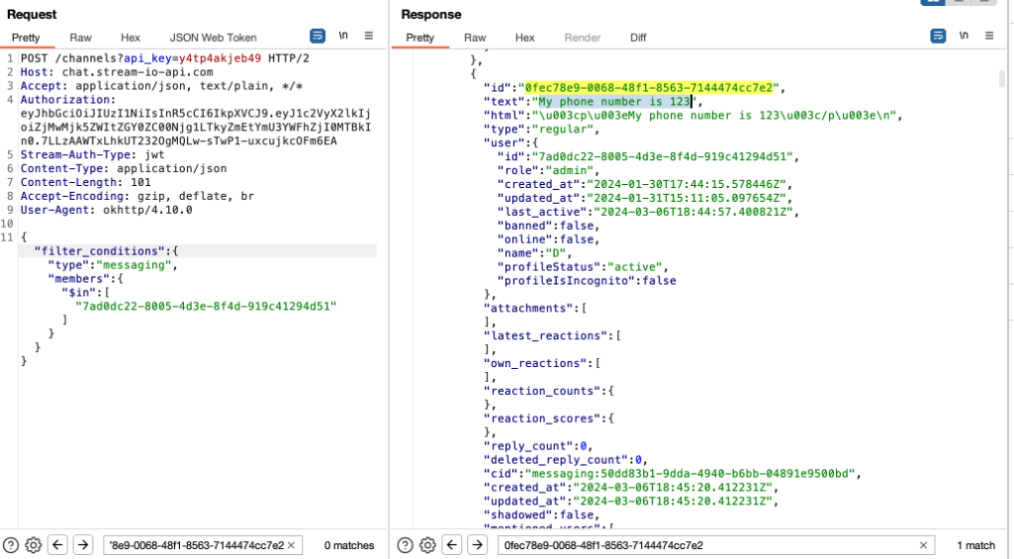
Vulnerability #4 –Delete, recover and edit other people’s messages
Reproduction steps:
2.And let’s use the previous vulnerability to ‘Read other people’s messages’ as the attacker, in order to find the messageID (‘0fec78e9-0068-48f1-8563-7144474cc7e2’)

Slide 48
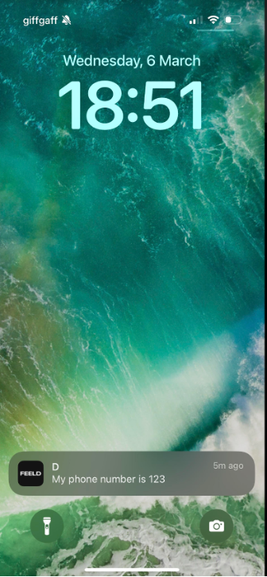
Vulnerability #4 –Delete, recover and edit other people’s messages
Reproduction steps:
3.The victim will receive a notification:

Slide 49
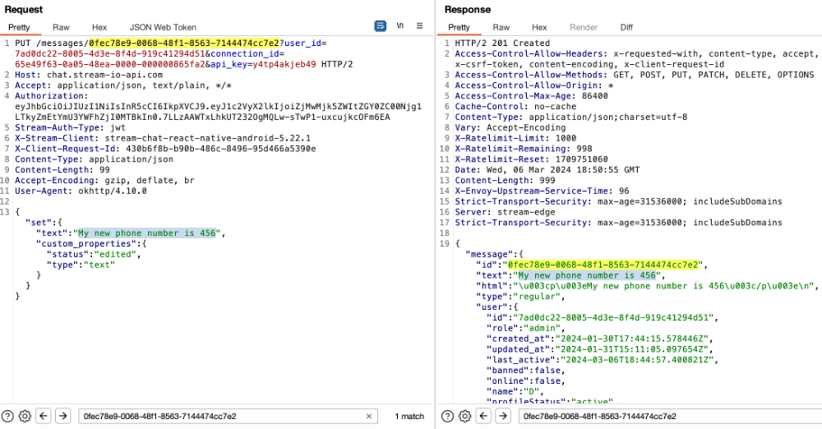
Vulnerability #4 –Delete, recover and edit other people’s messages
Reproduction steps:
4.Edit the message as the attacker, using the messageID and the method PUT on the same endpoint:

Slide 50
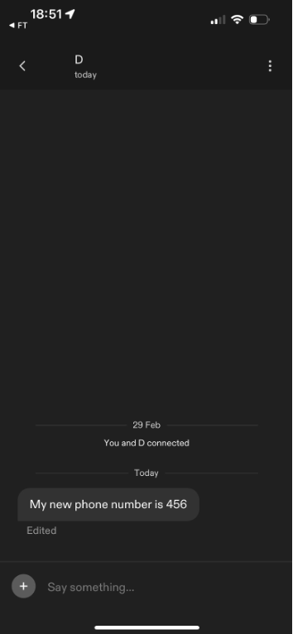
Vulnerability #4 –Delete, recover and edit other people’s messages
Reproduction steps:
5.When the victim taps on the notification from the above step 3, he will see the following message set by the attacker in step 4. There will be an ‘edited’ sign below the actual message but there are no signs of who did the edit. In addition, every account name is not unique and the attacker could choose any name possible.

Slide 51
Vulnerability #5 – Update someone else’s profile information
#1 Broken Object Level Authorization Category
Details: You can update someone else’s profile information, including name, sexuality, age, etc.
Instance: https://core.api.feeld.co/graphql (“operationName”:”ProfileUpdate”)

Slide 52
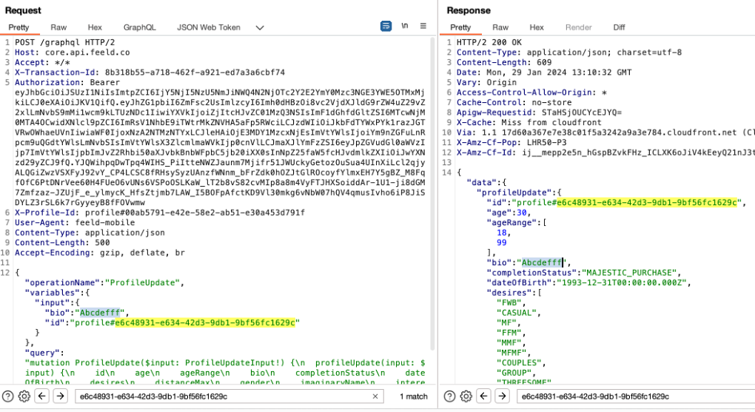
Vulnerability #5 – Update someone else’s profile information
Reproduction steps:
1.Let’s login the mobile application as the ‘attacker’ and go to the ‘Profile’ – ‘Edit Profile’ menu. 2.Edit 1 thing on the profile such as ‘bio’, save the change, and intercept the /graphql request with operationName: ‘ProfileUpdate’.
3.Modify in the intercepted request the ‘id’ parameter and add the id of your victim. In addition, add the parameters that you want to update, such as ‘bio’.

Slide 53
Vulnerability #6 - Get a ‘Like’ from any user profile
#1 Broken Object Level Authorization Category
Details: You could send ‘Likes’ from profile#2 to profile#3 while logged in as profile#1.
Instance: https://core.api.feeld.co/graphql (OperationName: ProfileLike)

Slide 54
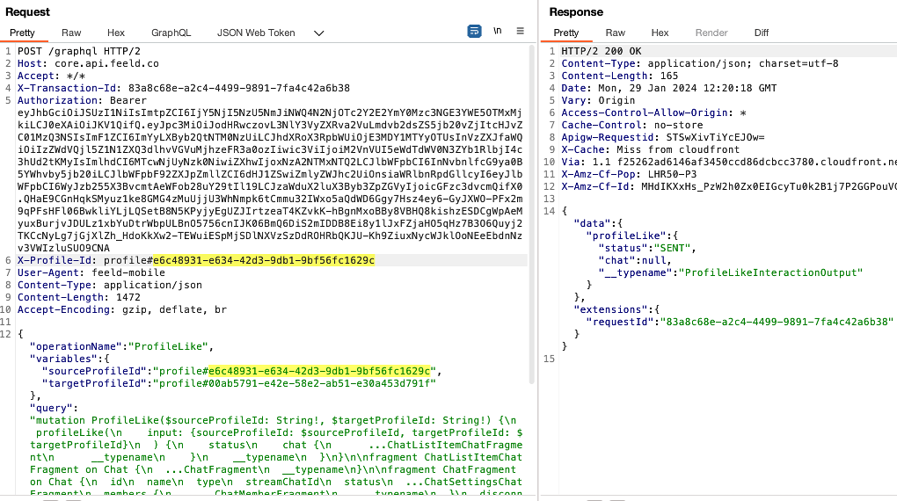
Vulnerability #6 - Get a ‘Like’ from any user profile
Reproduction steps:
1.Below is a request to send a normal ‘Like’, from user with profileId ending in ‘…9c’ to profileId ‘…1f’, and the successful response:

Slide 55

Vulnerability #6 - Get a ‘Like’ from any user profile
Reproduction steps:
2.Below is the request and response with a reverse like, from ‘…1f’ to ‘…9c’, which errors:

Slide 56

Vulnerability #6 - Get a ‘Like’ from any user profile
Reproduction steps:
3.Now, send a like from a random profile ‘….d3’ to one of our profiles ‘…1f’ , while logged in as user ‘…9c’:

Slide 57

Vulnerability #6 - Get a ‘Like’ from any user profile
Reproduction steps:
4.Now get the profile details (ImaginaryName) of that user with profileId ‘…d3’:

Slide 58

Vulnerability #6 - Get a ‘Like’ from any user profile
Reproduction steps:
5. Now, let’s check our list of likes in the app to see if we received a like from user ‘Anni’. Given that we have a Premium account, we can view this information in the app. Indeed, we can see that we have received a ‘Like’ from ‘Anni’:

Slide 59
Vulnerability #7 – Send messages in other people’s chat
#1 Broken Object Level Authorization Category
Details: We discovered that we can send messages to other people’s chats, even though we are not a participant in that chat.
Instance: https://chat.stream-io-api.com/channels/messaging/<ChannelID>/message (Method: POST)

Slide 60

Vulnerability #7 – Send messages in other people’s chat
Reproduction steps:
1. Use the previous vulnerability ‘Read other people’s messages’ to find the unique channelID where you want to add your message, such as the the one shown below: ’50dd83b1-9dda-4940-b6bb-04891e9500bd’: Add this channelID to the request path when you exploit this issue in step2 .
Read other people’s messages’ and find a ‘ChannelID’ value

Slide 61

Vulnerability #7 – Send messages in other people’s chat
Reproduction steps:
2.Send a message to that channel id:

Slide 62


Vulnerability #7 – Send messages in other people’s chat
Reproduction steps:
3.The victim will receive a notification, as seen on the right: Tap the notification and you will see the message. The victim cannot verify whether this message comes from the partner they matched with, or from a 3rd party, an attacker, like in this case.
The chat displayed on the right, is between 2 users: ‘D’ and ‘Bogdan’. Although, the system shows the notification is coming from user ‘B’ (the attacker’s name), the attacker can change their name on their profile, as this field is editable and not unique.

Slide 63
Vulnerability #8 – View other people’s matches
#1 Broken Object Level Authorization Category
Details: We can check who did other people match with and their full profile information, such as ‘imaginaryName’, age, photos, gender, sexuality, status, data of birth.
Instance: https://core.api.feeld.co/graphql (“operationName”:”ChatListQuery”)

Slide 64


Vulnerability #8 – View other people’s matches
Reproduction steps:
Enter the mobile application and go to the ‘Discover profiles’ menu.
It will make a request to /graphql with the “operationName”: “ChatListQuery”, as seen below:

Slide 65


Vulnerability #8 – View other people’s matches
Reproduction steps:
3. Change the profileId to that belonging to a victim user, such as: 00ab5791-e42e-58e2-ab51-e30a453d791f. Thus, we can view that account’s matches, as seen below:

Slide 66
Remediation
Developers:
1. Implement the authorization checks between users. These must be on the back-end and not front-end.
2. Implement user levels (ex: basic user, premium user).
3. Based on user levels, implement access controls between these & restrict the information returned to the user based un user level.
DevSecOps:
1.Integrate security tools in your CICD pipeline. Challenging for tools discovering IDORs (GUIDs).
CISO
1. Do data mapping – identify all personal data your org. collects, processes and stores, including where it is located and how it is used.
2. Implement Data Protection Measures: Introduce technical and organizational measures to protect personal data, such as encryption, access controls, and regular security testing.
Fines:
1. In July 2024, Uber was fined 290million Euros for violating the GDPR’s international data transfer rules, by transferring sensitive driver information to its US headquarters
2. In May 2025, Ireland DPC (Data Protection Comission) slammed TikTok With €530 Million GDPR Fine for sending EEA user data to China
Notes:
Developers:
1. Extra note here: Don’t give the attackers the chance to manipulate a parameter that should not even exist in the first case. (In a previous example we saw a user sending a Like from user A to user B. There is no need to have 2 parameters: sourceUser, and targetUser, because we already know the user that is logged in. So don’t give this chance to attackers to manipulate an extra parameter unnecessarily.

Slide 67
Remediation
Feeld:
Have remediated all the issues we flagged.
2024/03/08 – The disclosure of all the above issues to Feeld. 2024/03/08 – Feeld asked for the testing account details used during testing. 2024/04/02 – Feeld – ‘We are continuing to review the findings. Hence, if you can hold off publication … it would be helpful’ 2024/05/28 – Feeld: ‘we deployed several fixes. Thus, we kindly ask that you delay your findings for a maximum of 2 weeks, allowing us to confirm that we have resolved the flags in your report and ensuring that the safety of our Members remains sound’. 2024/06/08 – 3 months have passed since the initial disclosure email. 2024/06/20 – Feeld: ‘We appreciate your patience. Meanwhile, the team is cleaning up a few remaining items’. 2024/07/08 – 4 months have passed. 2024/07/15 – Feeld: ‘[…] a few issues still require a more complex set of remediations. […] we appreciate your allowing us time to fully resolve before publishing any of your findings’. 2024/08/04 – Feeld: ‘Our teams are actively working to resolve the remaining findings. Please hold off publishing until we can confirm that we have resolved these items.’ 2024/08/08 – 5 months have passed. 2024/08/16 – Feeld: ‘we have implemented the required changes to mitigate the remaining findings’. 2024/09/08 – 6 months have passed. 2024/09/10 – Blog published.

Slide 68
Full article
Research: https://fortbridge.co.uk/research/feeld-dating-app-nudes-data-publicly-available/
The Guardian:
https://www.theguardian.com/business/2024/sep/17/dating-app-feeld-personal-data-cybersecurity
Slides – Github – To be published:
https://github.com/orgs/FORTBRIDGE-UK/

Slide 69

Summary

Slide 70
See Our Leading Research Insights
For web app pentest research and a peek into PHP internals, check Multiple Concrete CMS Vulnerabilities (Part 1 – RCE): This article investigates achieving remote code execution through 2 race conditions vulnerabilities in the file upload functionality in Concrete CMS, providing a detailed examination of potential security risks and mitigation strategies.
For API testing research, check Mass Account Takeover in Yunmai Smart Scale API: This article details a pentest of Yunmai’s Android and iOS smart scale API, revealing several issues, including a chained attack leading to mass account takeover.
For our open source contribution to security tools, check Phishing Like a Pro: A Guide for Pentesters to Add SPF, DMARC, DKIM, and MX Records to Evilginx: This guide delves into advanced phishing techniques and how to effectively use SPF, DMARC, DKIM, and MX records with Evilginx for penetration testing.

Slide 71



Q
&
A

